Slide 1


Introduction to
Robotic Process Automation
AUTOMATED LAB RESULT NOTIFICATION SYSTEM
220701232
Rudrapriyan N
Dr . N. Durai Murugan, M.E., Ph.D.,
Associate Professor ,
Department of Computer Science and Engineering

Slide 2
Abstract
The "AUTOMATED LAB RESULT NOTIFICATION SYSTEM" project uses UiPath RPA to automate the process of handling lab test results and informing patients. It extracts test results from files, checks them for accuracy, and sends notifications to patients through email. This makes the process faster and reduces errors, saving time for labs and ensuring patients receive their results quickly and reliably. The project is designed to be simple and efficient, making it a helpful tool for healthcare management.
Department of Computer Science and Engineering
Rajalakshmi Engineering College ‹#›
Notes:
2

Slide 3
Need for the Proposed System
The proposed system is needed to address common challenges in managing lab test results and notifying patients. Manual processes can be time-consuming, prone to errors, and may lead to delays in delivering results. Patients often face anxiety due to late updates, while labs struggle to handle large volumes of data efficiently. By automating result processing and notifications, the system ensures faster, accurate, and reliable communication, reducing the workload for lab staff and improving the overall experience for patients. This solution simplifies operations, enhances productivity, and builds trust through timely updates.
Department of Computer Science and Engineering
Rajalakshmi Engineering College ‹#›
Notes:
3

Slide 4
Advantages of the Proposed System
Time Efficiency: Manual handling of lab test results and notifications is time-consuming and slows down the process.
Error Reduction: Manual data entry and communication can lead to mistakes, affecting accuracy and reliability.
Timely Notifications: Patients often face delays in receiving their test results, causing unnecessary anxiety.
Improved Patient Experience: Timely and accurate notifications build trust and satisfaction among patients.
Operational Efficiency: Reduces the workload for lab staff, allowing them to focus on other critical tasks.
Department of Computer Science and Engineering
Rajalakshmi Engineering College ‹#›
Notes:
4

Slide 5
Literature Survey
Paper
The paper titled "Automated alert and activation of medical emergency team using early warning score" by Soo Jin Na et al., published in the Journal of Intensive Care (2021), explores the implementation of an automated system for triggering Medical Emergency Team (MET) activation.
Advantages : - Timely Activation, Improved Patient Safety
Disadvantages :- Hospital Dependency, Limited Scope(Critical Care Scenario)
Department of Computer Science and Engineering
Rajalakshmi Engineering College ‹#›
Notes:
5

Slide 6
Main Objective
The main objective of the "AUTOMATED LAB RESULT NOTIFICATION SYSTEM" project is to automate the process of handling lab test results, ensuring accurate data processing and timely notifications to patients. By leveraging UiPath RPA, the system aims to reduce manual effort, eliminate errors, and enhance efficiency in delivering lab results to patients, ultimately improving the overall healthcare experience.
Department of Computer Science and Engineering
Rajalakshmi Engineering College ‹#›
Notes:
6

Slide 7
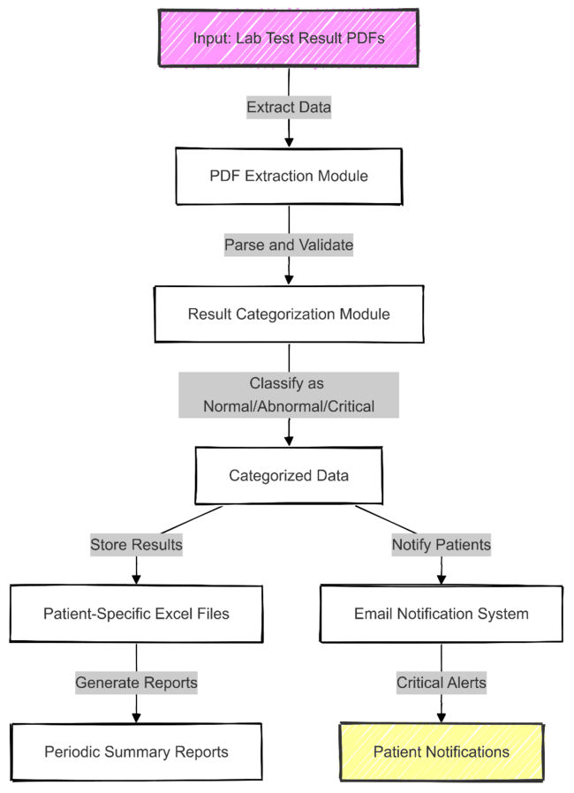
Architecture
Department of Computer Science and Engineering
Rajalakshmi Engineering College ‹#›
Notes:
7

Slide 8
System Requirements
HARDWARE:-
Processor: Minimum 2.0 GHz dual-core processor or higher.
RAM: 4 GB or more.
Hard Disk: 500 MB free space for installing the software and storing test results.
Network: Internet connection for sending notifications via email
SOFTWARE:-
Windows 10 or higher (for UiPath).
UiPath Studio - Version 2020 or later.
Microsoft Excel for storing patient test results in Excel files.
SMTP server for email notifications
Department of Computer Science and Engineering
Rajalakshmi Engineering College ‹#›
Notes:
8

Slide 9
Functional Description
Lab Results Automation and Notification
This module automates the extraction of lab test results from PDF files, validates and categorizes them (normal, abnormal, or critical), and notifies patients via email. The processed results for each patient are stored in individual Excel files for easy access and record-keeping.
Department of Computer Science and Engineering
Rajalakshmi Engineering College ‹#›
Notes:
9

Slide 10
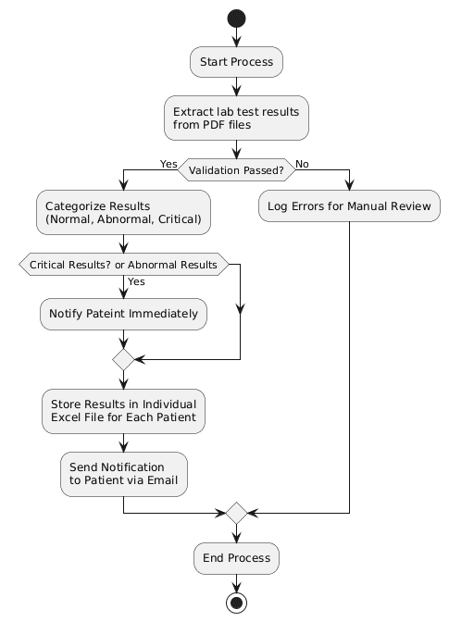

Slide 11
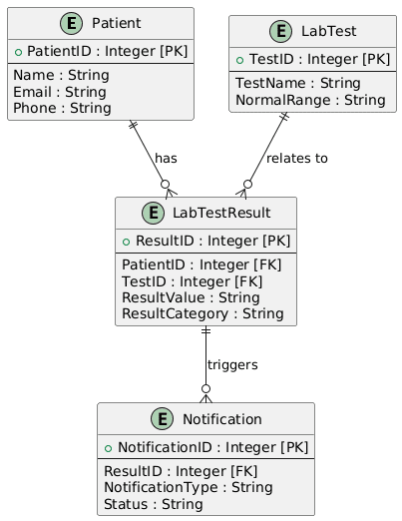
Table Design
Department of Computer Science and Engineering
Rajalakshmi Engineering College ‹#›
Notes:
10

Slide 12
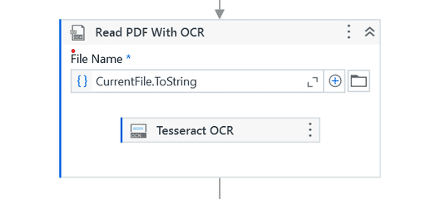
Implementation
Module Implementation
PDF Data Extraction
Data Validation
Result Categorization
Storing Results in Excel
Notification Trigger
Screen shots
PDF Data Extraction
Department of Computer Science and Engineering
Rajalakshmi Engineering College ‹#›
Notes:
12

Slide 13
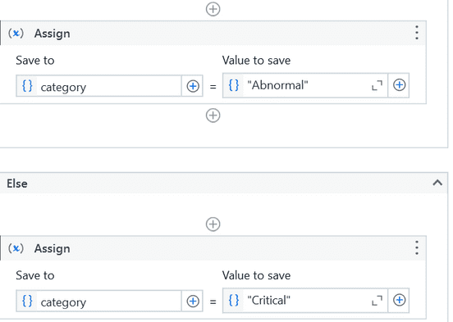
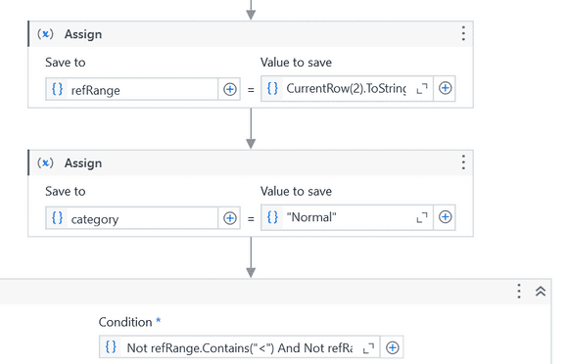
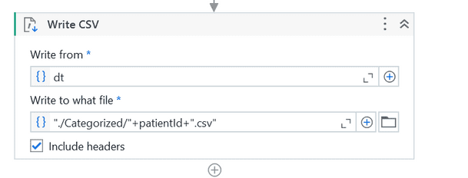
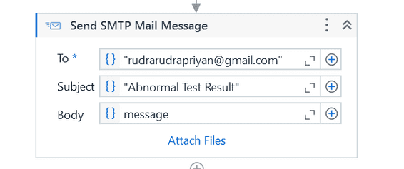
Implementation
Data Validation
Result Categorization
Storing Results in Excel
Notification Trigger
Department of Computer Science and Engineering
Rajalakshmi Engineering College ‹#›
Notes:
12

Slide 14
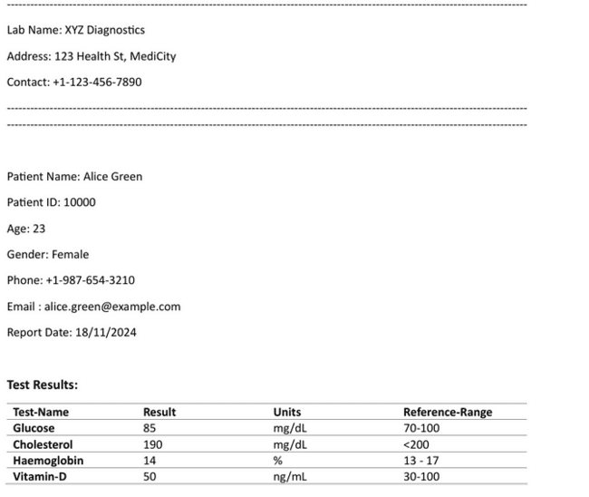
Testing
Department of Computer Science and Engineering
Rajalakshmi Engineering College ‹#›
Notes:
13

Slide 15
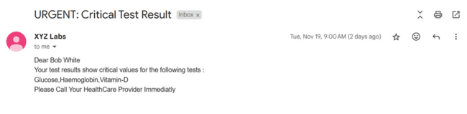
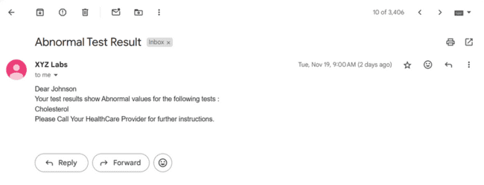
Testing
Department of Computer Science and Engineering
Rajalakshmi Engineering College ‹#›
Notes:
13

Slide 16
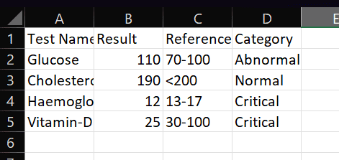
Testing
Department of Computer Science and Engineering
Rajalakshmi Engineering College ‹#›
Notes:
13

Slide 17
Conclusions
In conclusion, the "Automated Lab Result Notification System” project automates the handling of lab test results and notifications, improving efficiency and accuracy. By using UiPath RPA, the system reduces errors and ensures timely delivery of results to patients via email . This automation saves time for healthcare professionals and enhances the patient experience by providing quick and reliable updates. The project offers a practical solution to streamline lab operations and improve communication in healthcare management.
Department of Computer Science and Engineering
Rajalakshmi Engineering College ‹#›
Notes:
14

Slide 18
Future Enhancement
Advanced Data Analytics: Implement data analytics to track trends in lab results, helping to predict potential health risks and providing actionable insights for doctors and patients.
Multi-Channel Notification System: Expand the notification options to include push notifications via mobile apps or web portals for more instant communication.
Real-time Result Processing: Introduce real-time processing of lab test results, reducing wait times for urgent tests and improving response times for critical conditions.
Department of Computer Science and Engineering
Rajalakshmi Engineering College ‹#›
Notes:
15

Slide 19
References
[1] Kumar, R. & Sharma, A. (2023). Robotic Process Automation in Healthcare: Revolutionizing Lab Test Result Management. Journal of Healthcare Automation, 25(4), 340-345.
Singh, R., & Gupta, P. (2021). Improving Lab Test Processes through Automation: The Role of Robotic Process Automation. International Journal of Medical Informatics, https://doi.org/10.1016/j.ijmedinf.2021.104858. 45(7), 1212-1217.
Department of Computer Science and Engineering
Rajalakshmi Engineering College ‹#›
Notes:
17

Slide 20
Queries
Notes:
18

Slide 21
Demonstration
Notes:
19

Slide 22
Thank You
Notes:
20

